Slide 1
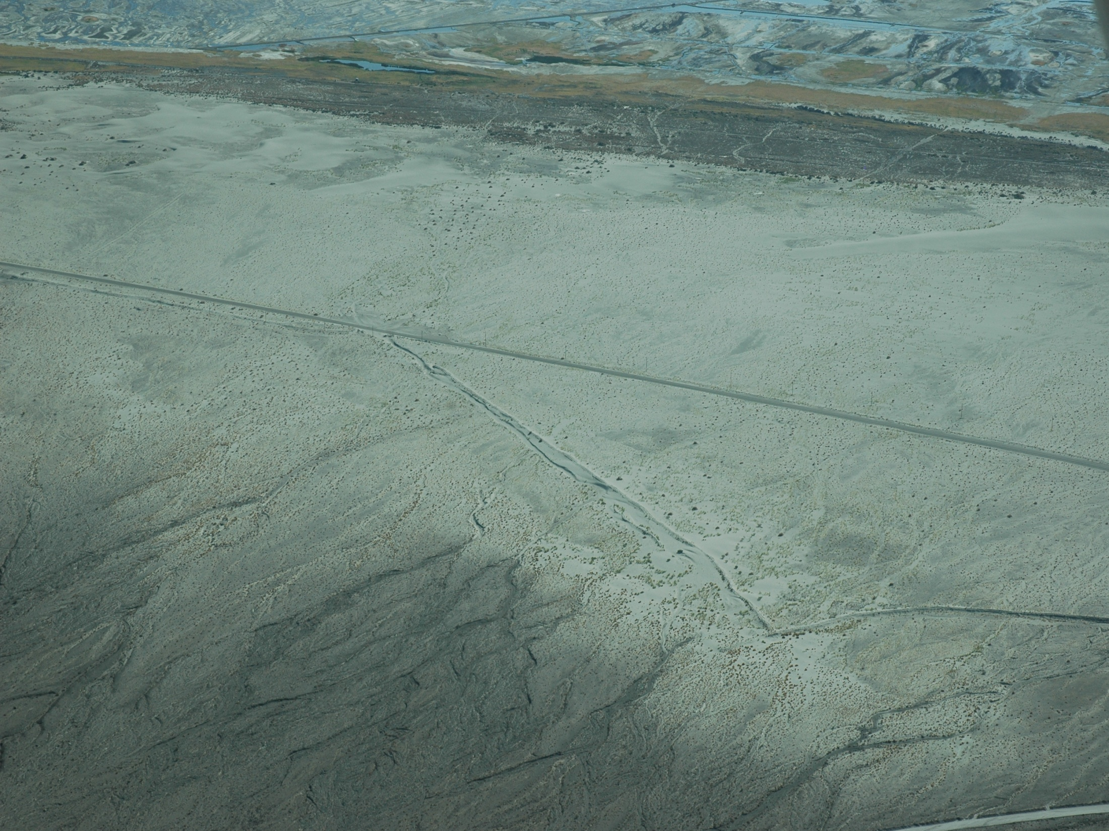

Workshop on the
Origin and Development of the
Keeler Dunes
Part 1: Background Presentation
Great Basin Unified Air Pollution Control District
Governing Board Meeting
March 7, 2013
Oblique aerial photo with view to south across Keeler Dunes – Sept 2008

Slide 2
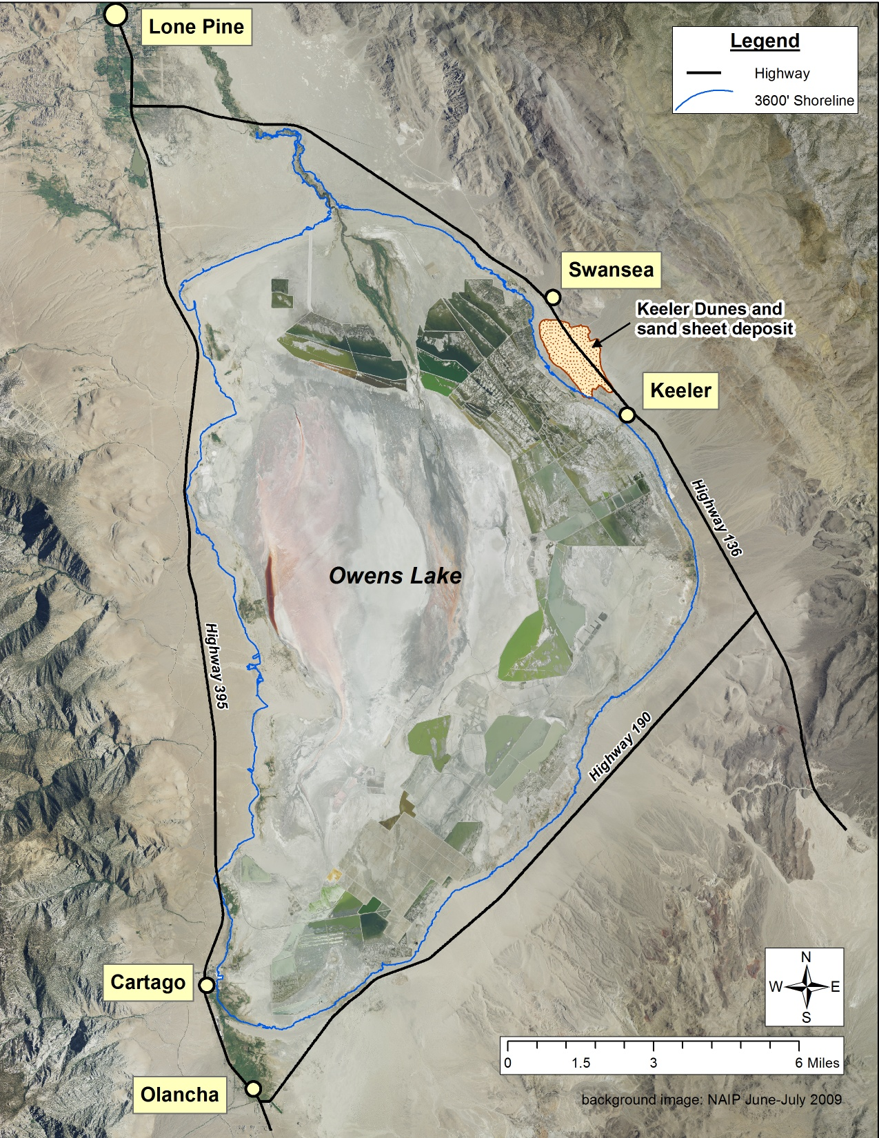
Location of Modern Keeler Dunes
Notes:
Point out location of Owens Lake, Towns, Highways and Keeler Dunes

Slide 3
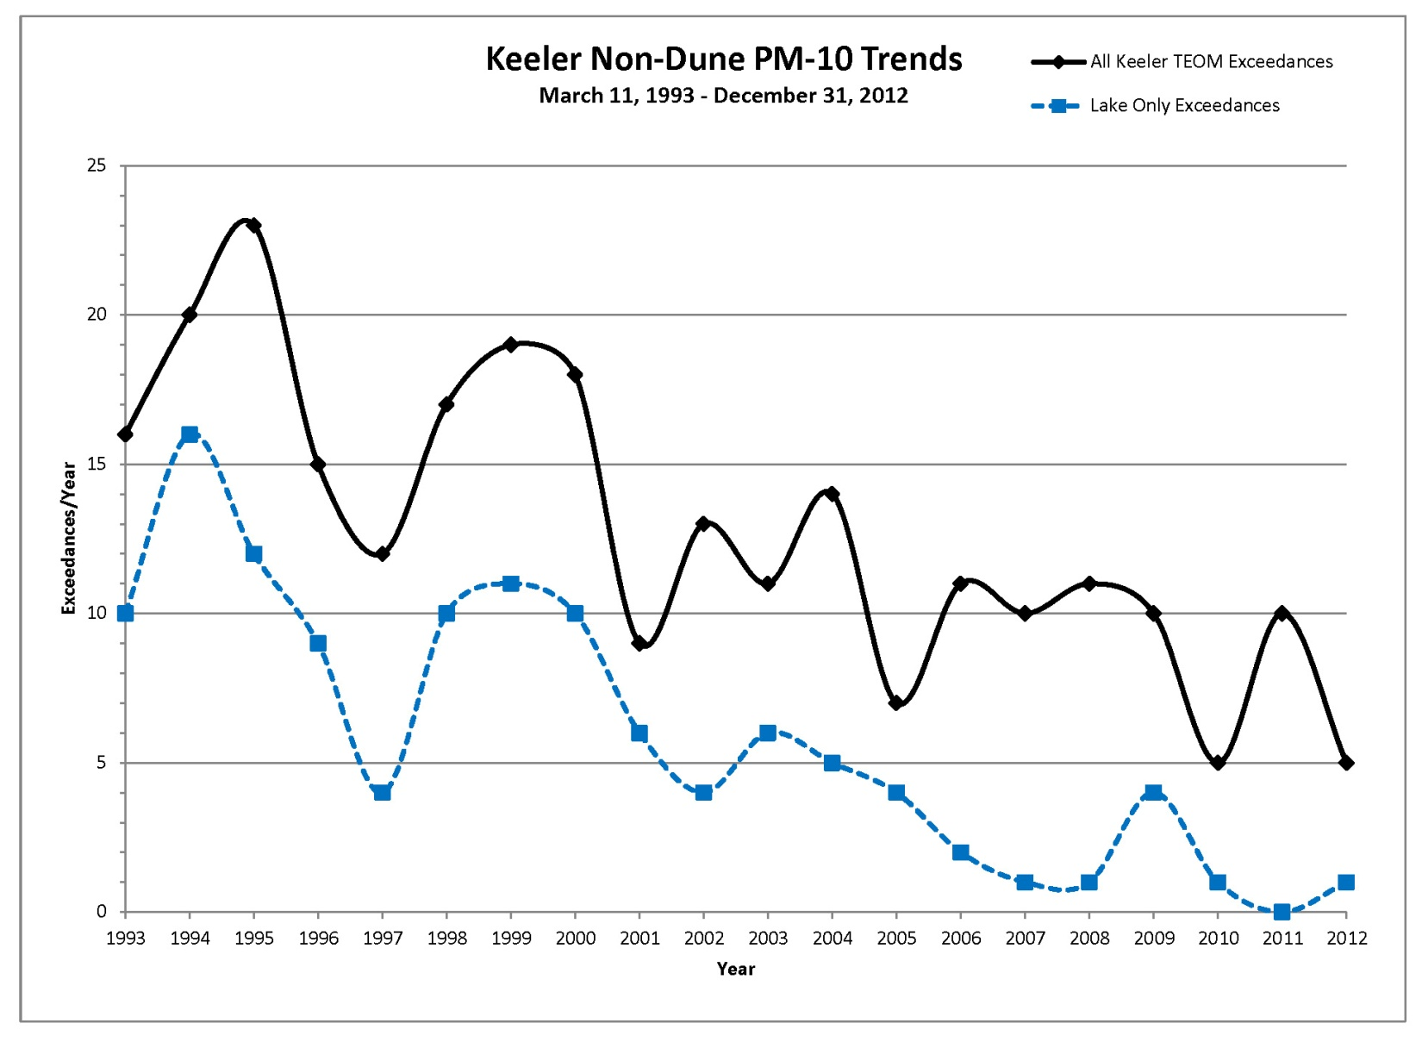
Keeler PM10 Data
TOTAL = 256
NO dust controls
First dust controls
More dust controls
Additional dust controls
One allowed exceedance
per year
Number of exceedances of Federal PM₁₀ standard more than allowed by CAA
Dust emissions directly impact local residents and workers
Dust impacts public safety on State Highway 136
Notes:
Discussion on why emissions from Keeler Dunes need to be controlled
overall KD cause ~47% of total number of exceedances in Keeler
1993-2001 (pre-dust controls) – KD caused 30% of exceedances in Keeler
2002 – 2012 (post-dust controls) – KD cause 70% of exceedances in Keeler

Slide 4
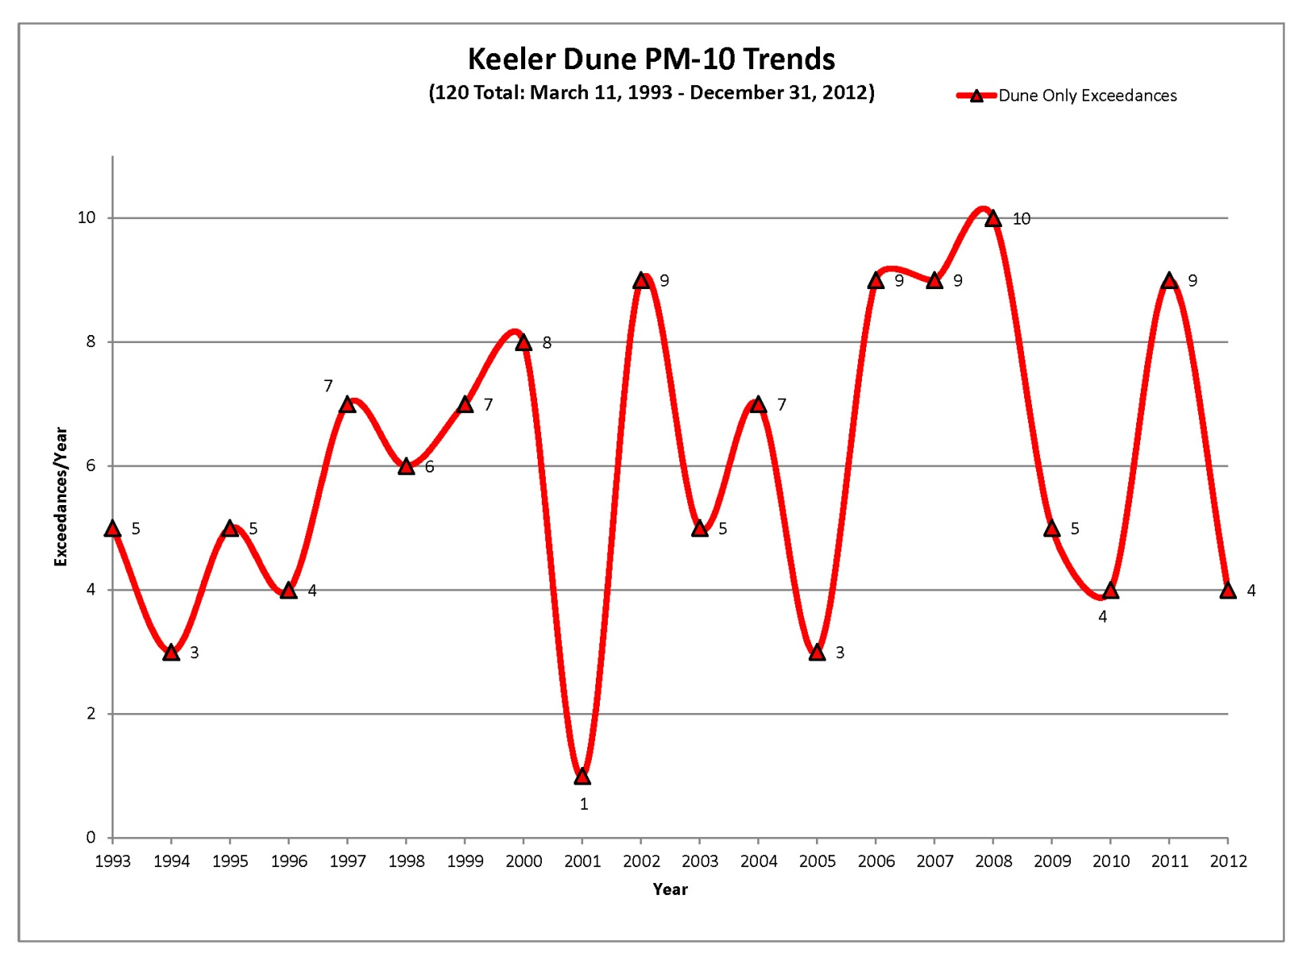
Keeler Dunes Require Dust Controls
DUNES TOTAL = 120
One allowed exceedance
per year
PM₁₀ emissions from Keeler Dunes cause an average of 6 violations of health standard per year
Notes:
Discussion on why emissions from Keeler Dunes need to be controlled
overall KD cause ~47% of total number of exceedances in Keeler
1993-2001 (pre-dust controls) – KD caused 30% of exceedances in Keeler
2002 – 2012 (post-dust controls) – KD cause 70% of exceedances in Keeler

Slide 5
Graph of the PM₁₀ concentrations from the Keeler Dunes for exceedance days, measured at the Keeler Monitoring station from 1993 to 2012.
Notes:
Summary graph of PM10 concentrations from the Keeler Dunes at the Keeler Air Monitoring Station [update through 2012]
Average of 6 exceedances per year
Highest concentration measured on 12/28/2006 of 2,097 υg/m3
Notice that rest of values are relatively constant over the time span monitored (ranging from ~ 300 to 800 υg/m3)

Slide 6
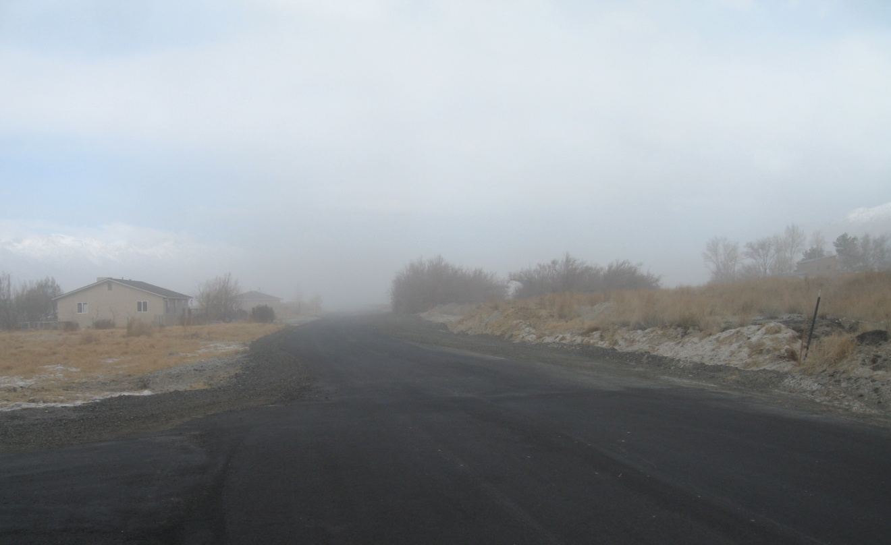
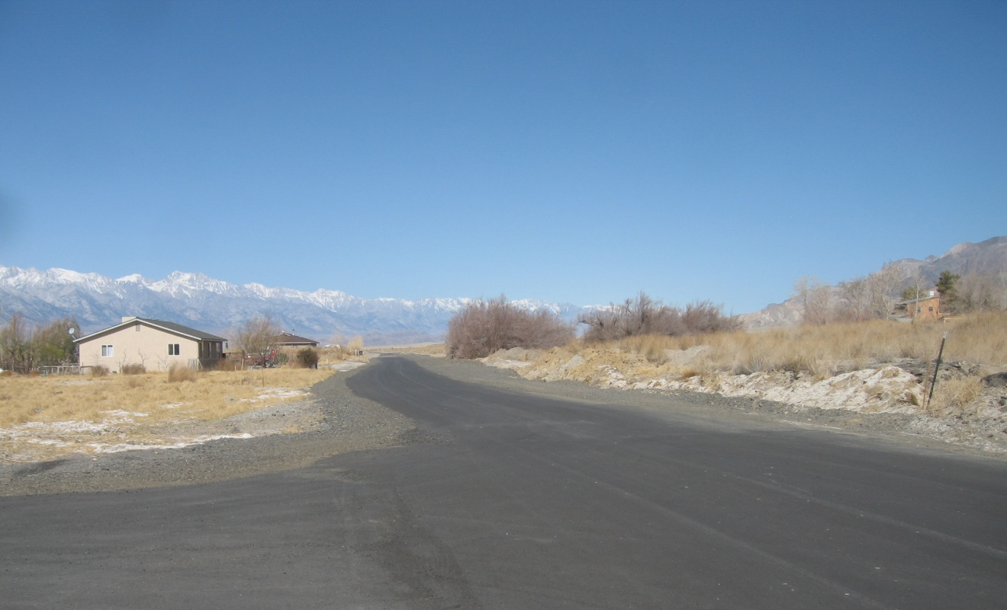
View from Keeler toward dunes – February 20, 2013
PM₁₀ concentrations
Hourly = 1,400 μg/m³
24-hour = 526 μg/m³
Health Alerts
Stage 1 > 400 μg/m³ per hour
Stage 2 > 800 μg/m³ per hour
View from Keeler toward dunes – March 4, 2013
Notes:
Photos of Keeler on a dusty and dust-free day.
Dusty day on February 20, 2013 – hourly dust concentration - ~1400 µg/m 3, 24-hour concentration = 526 µg/m 3
Clear day = March 4, 2013
Health Alerts:
Stage 1: A Stage 1 air pollution health advisory is issued when hourly particulate pollution levels exceed 400 microgram per cubic meter (µg/m 3). A Stage 1 health advisory will recommend that children, the elderly, and people with heart or lung problems refrain from strenuous outdoor activities in the impacted area.
Stage 2: A Stage 2 air pollution health advisory is issued when hourly particulate pollution levels exceed 800 µg/m 3. A Stage 2 health advisory will recommend that everyone refrain from strenuous outdoor activities in the impacted area.

Slide 7
Dust Control Requirements - 2008 SIP
Attainment of the Federal PM₁₀ standard in Owens Valley Planning Area (OVPA) required by 2017.
The 2008 SIP orders control of 43 square miles of the lake bed sources plus requires additional controls should additional PM₁₀ dust sources become identified.
2008 SIP attainment demonstration specifically deals with the control strategy for Owens Lake bed PM₁₀ sources and also identifies the Keeler Dunes as requiring controls.
Control of PM₁₀ emission from the Keeler Dunes is required by 2014.
2006 Settlement Agreement between the GBUAPCD and the LADWP and the 2008 SIP both provide for cooperative study of the Keeler Dunes with LADWP.
Notes:
Owens Valley Planning Area (OVPA) was designated as a serious non-attainment area for PM10 in 1993
State Implementation Plans was prepared in 1997 and was revised in 1998, 2003 and 2008 for plan to bring the OVPA into attainment with CAA
The 2008 SIP requires control of 43 square miles of the lake bed plus requires additional controls should additional PM10 dust sources become identified.
2008 SIP includes order for control of sources on Owens Lake AND clearly states that controls are required in Keeler Dunes to meet attainment of PM10 standard in OVPA

Slide 8
Keeler Dunes Project Timeline
2000 - 2013
2013
December – Public Hearing
November – Final Staff Report
September – Preliminary Staff Report
2012
MAY
Continued Public Hearing
LADWP begins independent work
Second Public Meeting
(Board Discussion)
First Public Meeting
2011
Public Workshop
March
Public
Workshop
2010
2006 Settlement Agreement
2009
2008
Keeler Dunes Investigation Begins
2008 State Implementation Plan (SIP) Approved
Monitoring
Begins
2007
2006
2000

Slide 9
4 Step Process Leading Up to May Public Hearing
1.
February and May 2012
Board Discussion
July 2012
Board approved process, LADWP approval
Sept 7, 2012
Preliminary Staff Report
October 26, 2012
Comment period
(7 weeks)
November 16, 2012
Response to comments
Nov 16, 2012
Final Staff Report
November 28, 2012
Second comment period (~2 weeks)
November 28, 2012
Preparation of materials for Board
December 10, 2012
Response to additional comments
Dec 13, 2012
Public Hearing
December 13, 2013
LADWP submits materials
May 2013
Continued
Public Hearing
March 7, 2013
Public Workshop
2.
3.
4.

